Slide 1
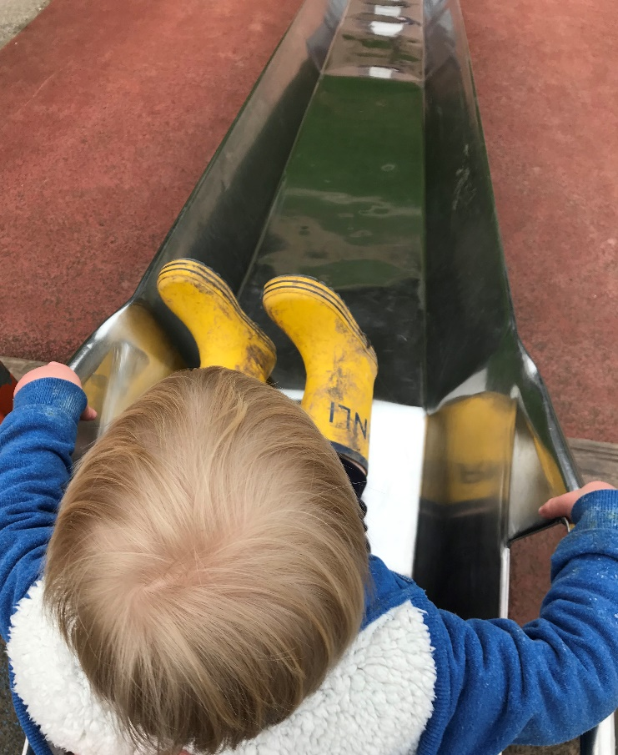
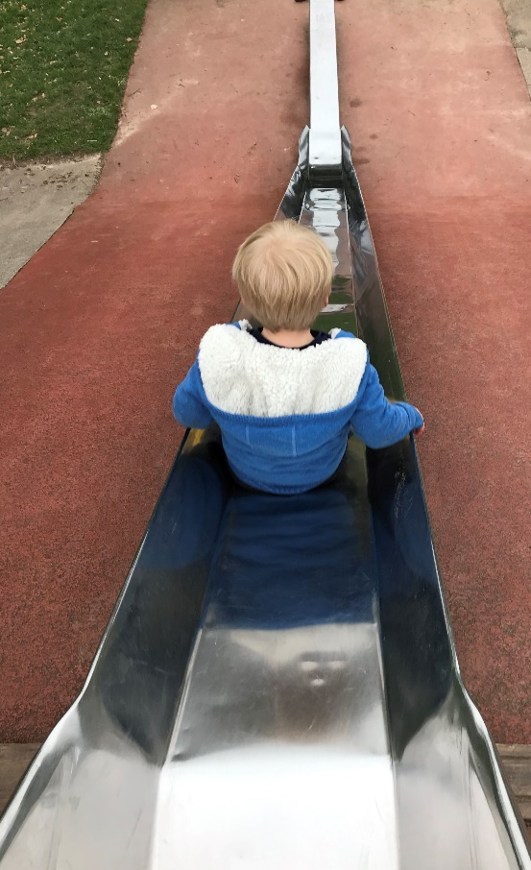
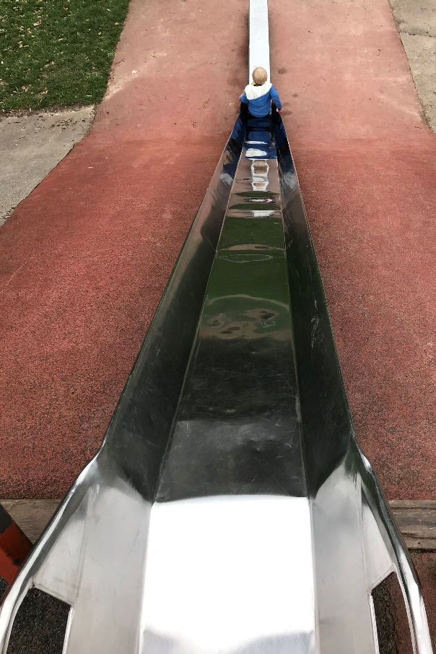
Friction
Year 5

Slide 2
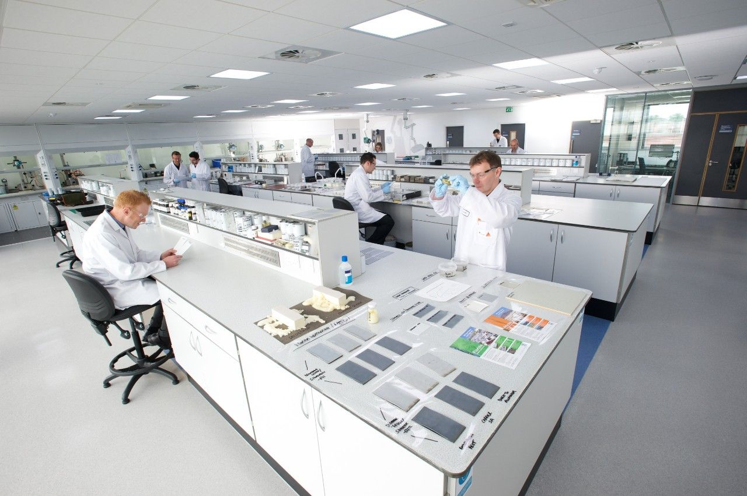
Hello!
We are Sika
We make materials that are used to make new buildings and repair old ones.

Slide 3
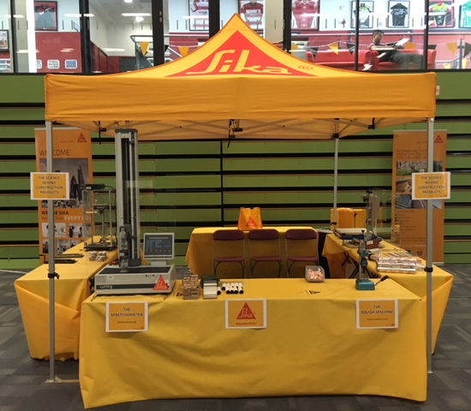
Do you remember?
Do you remember seeing us at the Lancashire Science Festival?
This was our stand…

Slide 4
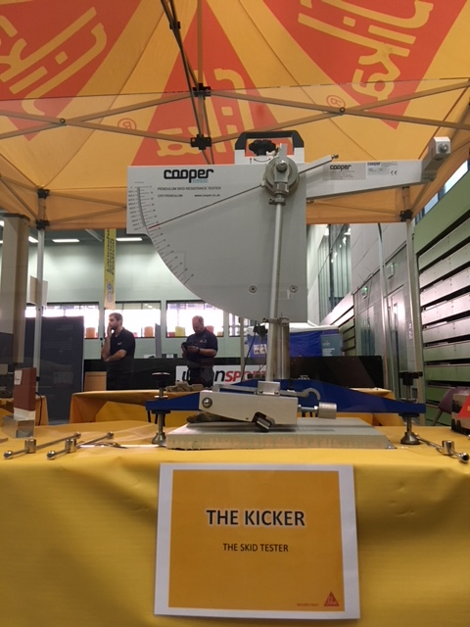
The Kicker
One of the pieces of equipment on our stand was “The Kicker”.
We use it to test how slippy a surface is.

Slide 5
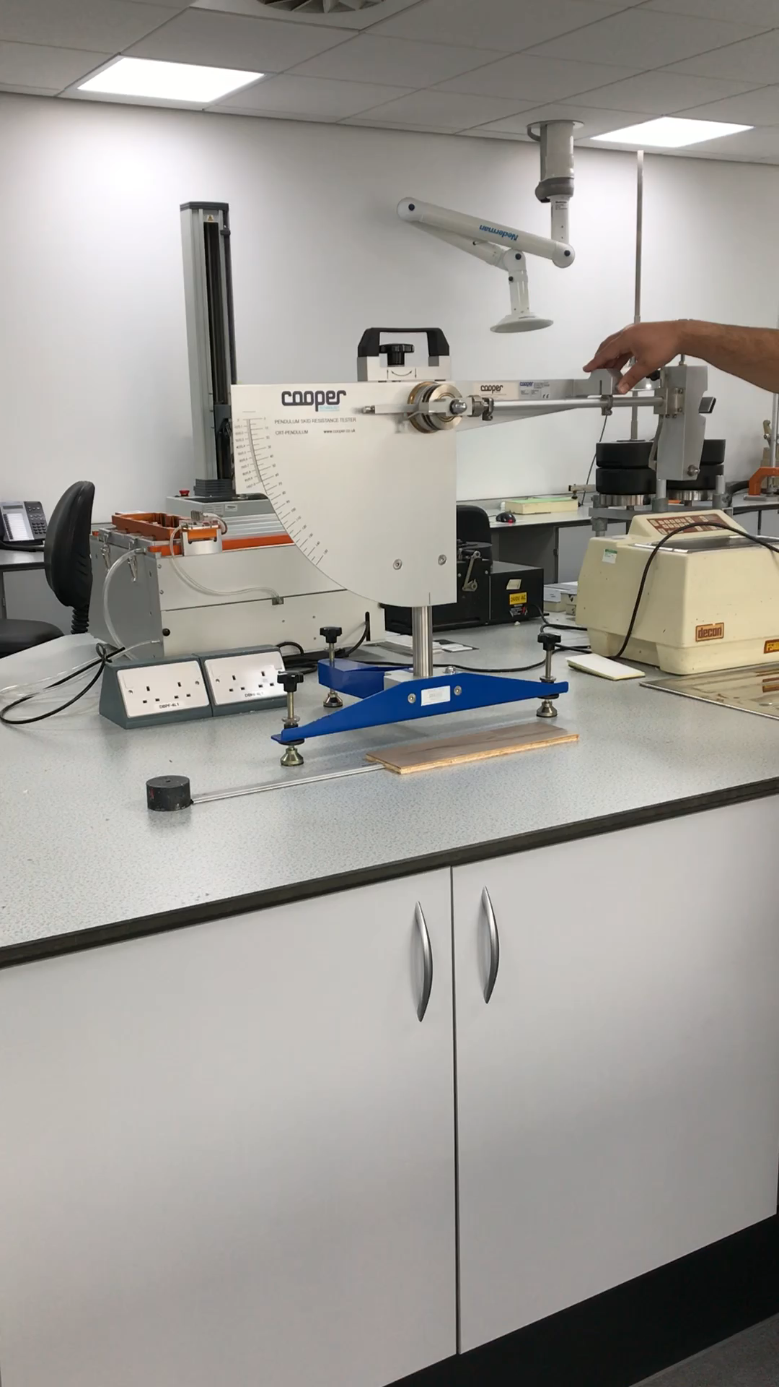
The Kicker
One of the pieces of equipment on our stand was “The Kicker”.
We use it to test how slippy a surface is.
Scale
Boot
Needle
Stand
Test Material
Notes:
Animated diagram introduces the separate parts of the machine.
How The Kicker works: The boot swings and moves across the test sample, taking the needle with it. The slippier the material is the futher the boot and needle will move.
3) Short video of machine in use.

Slide 6
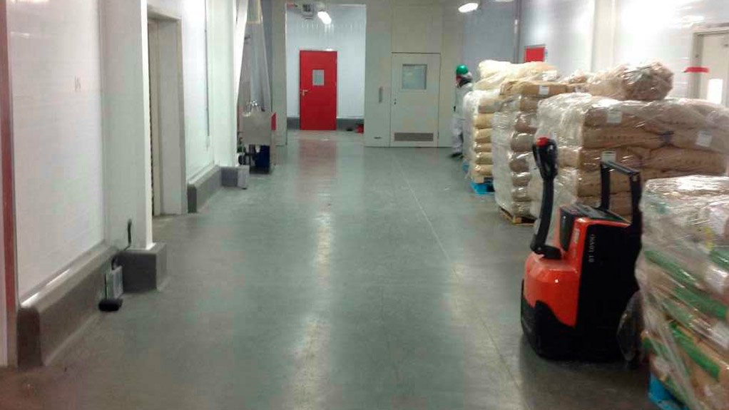
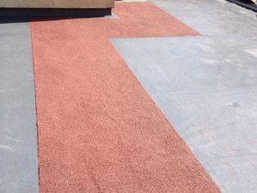
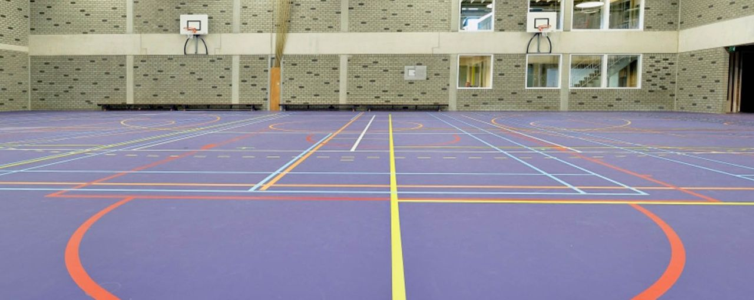
Why do we test this?
There are rules about how slippy a floor can be.
The rules are different for different rooms e.g. swimming pool/changing room must have a rougher surface than a sports hall.
We need to know whether our products fit these rules.
If we change the type or quantity of ingredients we use when making our flooring products it might change how slippy they are.
Notes:
Ask Sarah James to send some photos

Slide 7
Investigating Surfaces
Learning Objective:
To identify the effects of friction acting between moving surfaces
Today, we are going to carry out a similar investigation on a variety of surfaces to see which one has the most friction and so would make moving an object on it most difficult.

Slide 8
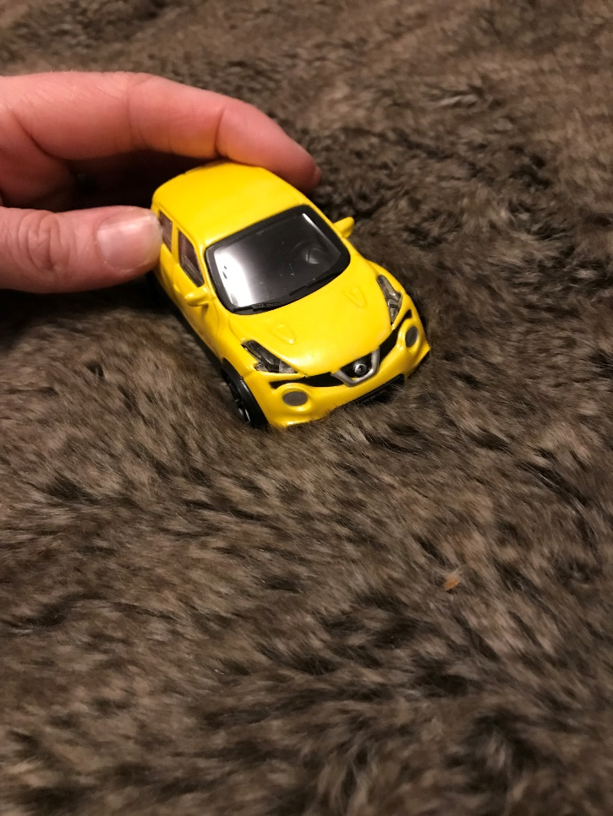
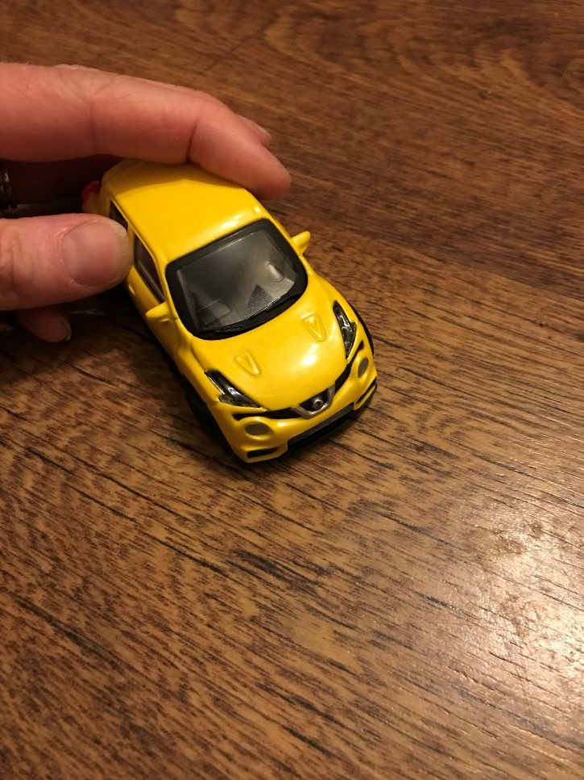
Investigating Surfaces
When the car is pushed with the same force:
A
B
Which surface will the car move quickest over?
Across which surface will the car move the furthest?

Slide 9
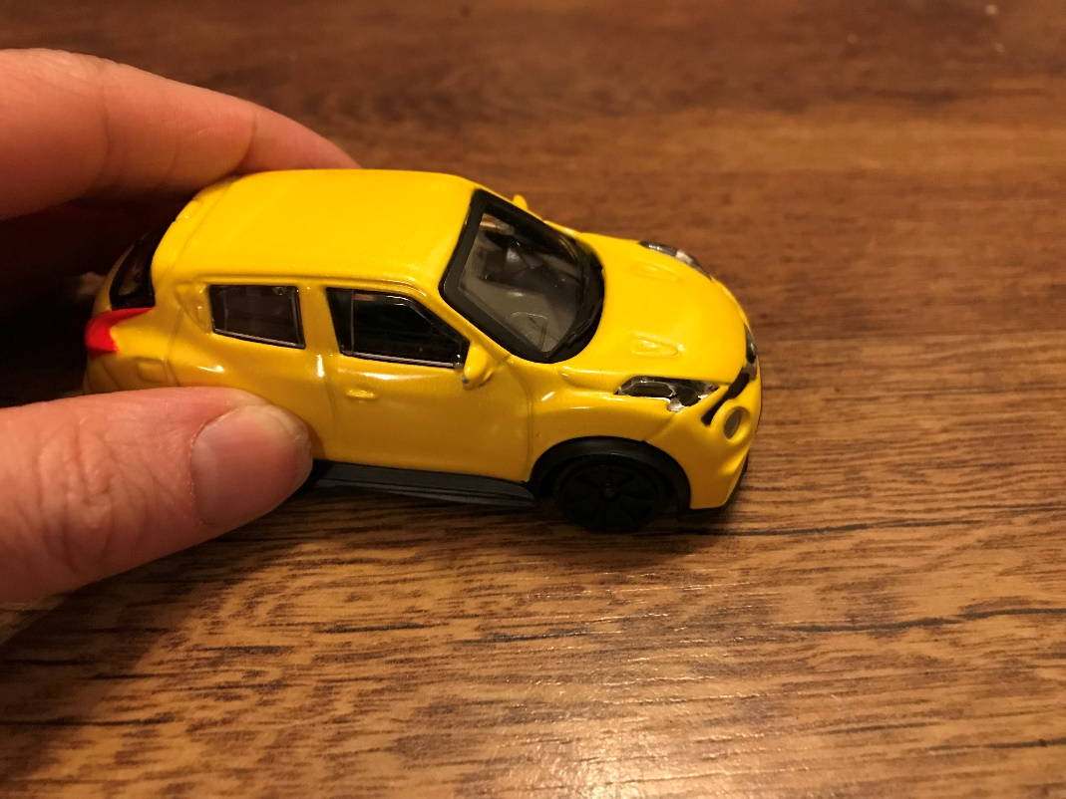
Friction is a Force
We can make objects move by pushing or pulling them across a surface. There is a force acting between the surface and the object that can make it harder for the object to move. This force is called friction.
Motion
Pushing force
Friction

Slide 10
How do you define friction?
Discuss with your partner

Slide 11
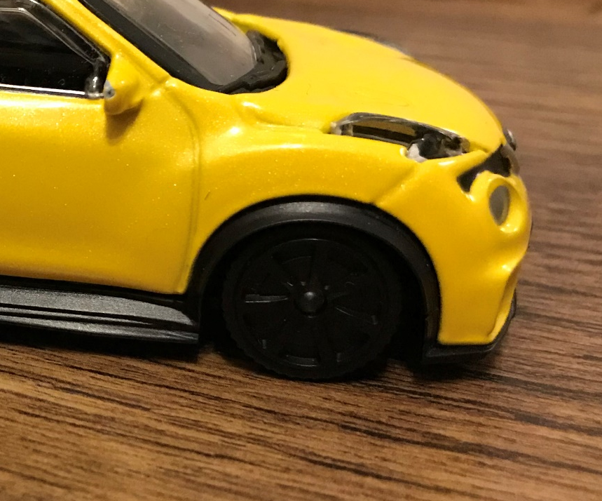
Definition of friction
The resistance that one surface or object encounters when moving over another.
The action of one surface or object rubbing against another.
In this example the wheels and floor will rub against each other – there will be resistance
Rubbing Resistance

Slide 12
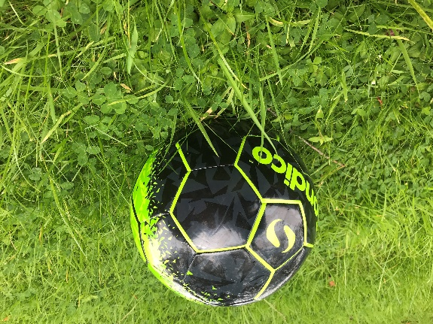
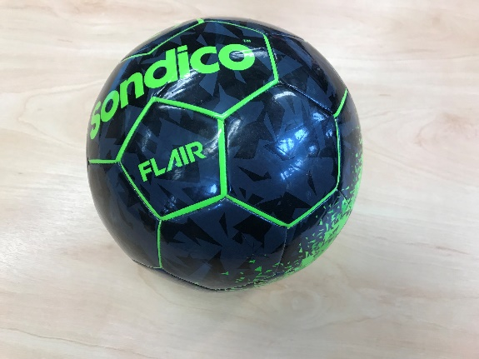
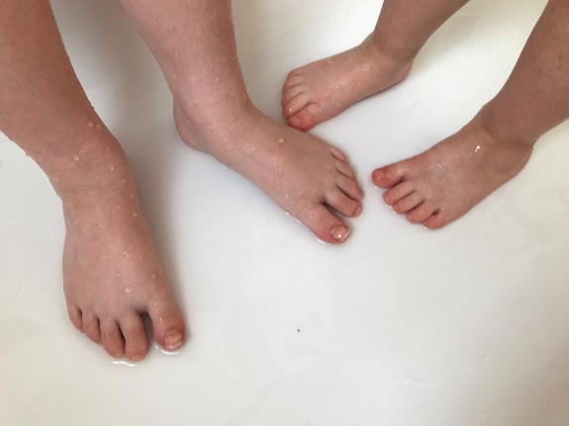
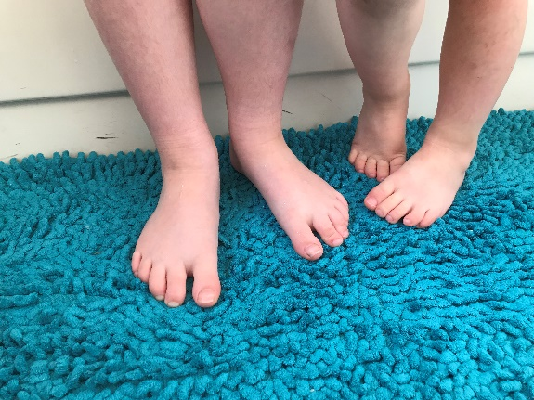
Examples of friction
Which will have more resistance?
A ball on grass or on a sports hall floor?
Wet feet in a bath or on a bath mat?
Discuss with your partner

Slide 13
examples of High and Low friction
High Friction
Sledge on grass
Sandpaper on wood
Low Friction
Skis on snow
Feet on a wet bath
Can you think of some of your own examples to add to the list?
Notes:
Child on slide – high or low depending on clothing/slide material etc.
Skis/snowboard/sledge on snow
Ice skates on ice rink
Bowling ball & alley at 10 pin bowling
Rubbing hands together
Breaks on a car or bicycle
Bicycle on beach

Slide 14
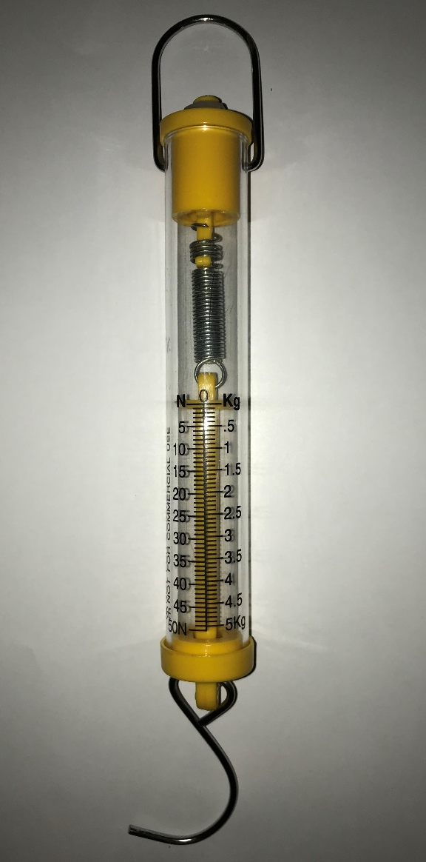
What is this?
What do you think it measures?
Why does it have a hook on one end?
How do you think it works?

Slide 15
A Forcemeter
A forcemeter measures forces. Forces are measured in Newtons.
The hook helps you to attach the object to be measured to the forcemeter.
The other end of the hook is attached to a spring inside the forcemeter. When a force is applied to the hook the spring stretches. When the spring stops a reading can be taken.

Slide 16

Time to plan!
How can we use a forcemeter to investigate which surface has the most friction?
Pull
0
10
20
30
40
50
60
70
80
90
100
110
120
130
140
150
We can pull an object across a surface with the forcemeter and record the reading on the worksheet.
BUT…

Slide 17
Time to plan!
How can we make it a fair test?
Have the same person perform each test
Use the same object each time
?
Repeat the test several times
Use the same forcemeter
Always have a flat surface

Slide 18
Time to plan!
The surfaces we will be testing are:
(TEACHER TO INPUT SURFACES THAT THEY HAVE CHOSEN)
What do you think will happen?
Please complete the predictions section on your worksheet.
Now let’s start our investigation!

Slide 19
plenary
What did we find out from our investigation?

