Slide 1
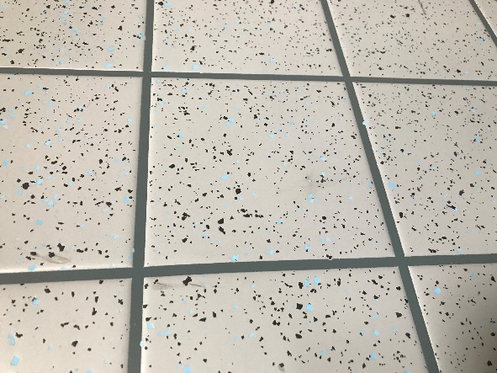
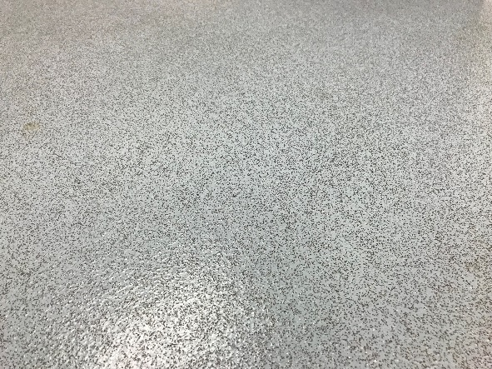
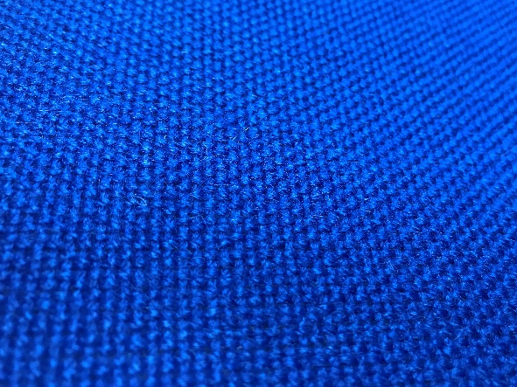
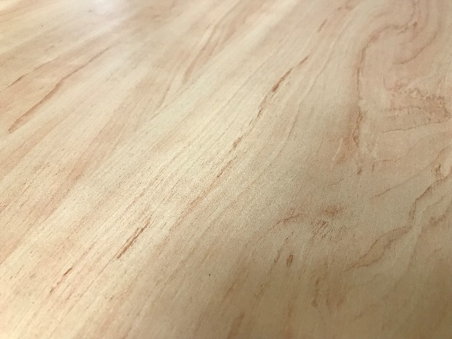
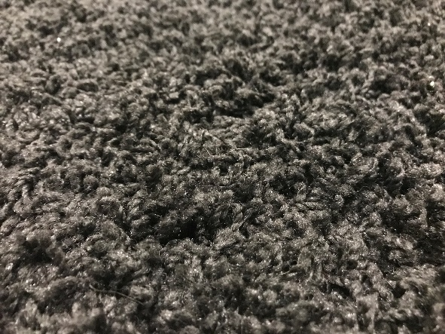
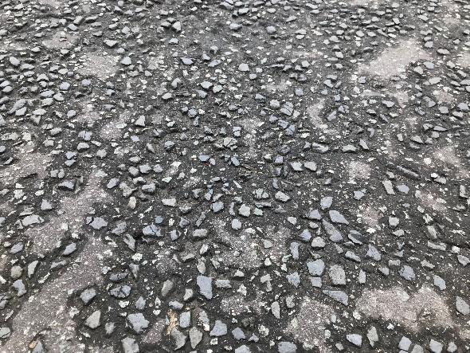
Investigating Surfaces
Year 3

Slide 2
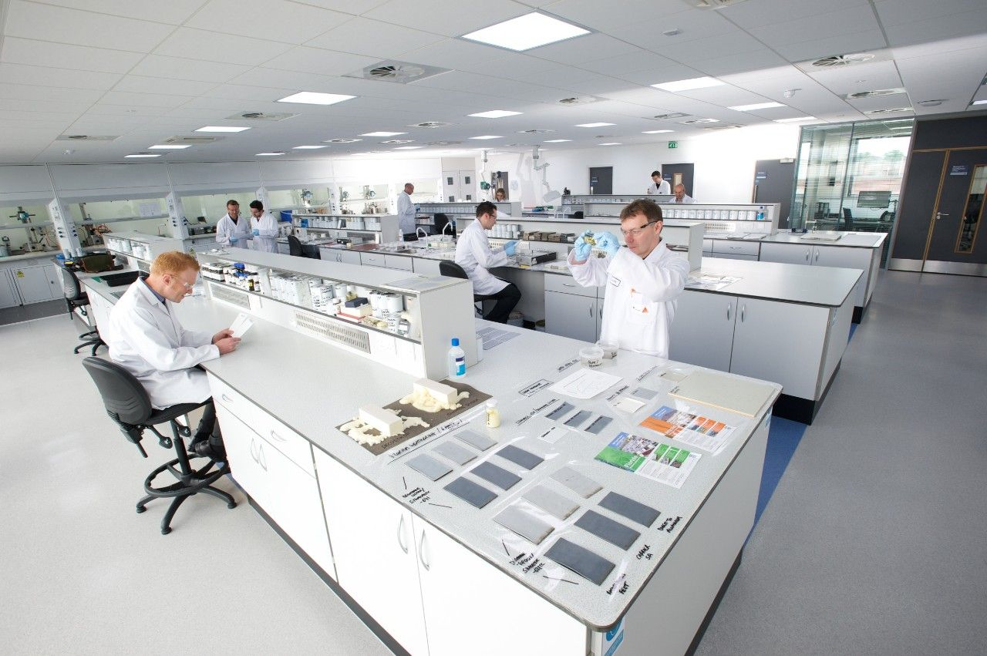
Hello!
We are Sika
We make materials that are used to make new buildings and repair old ones.

Slide 3
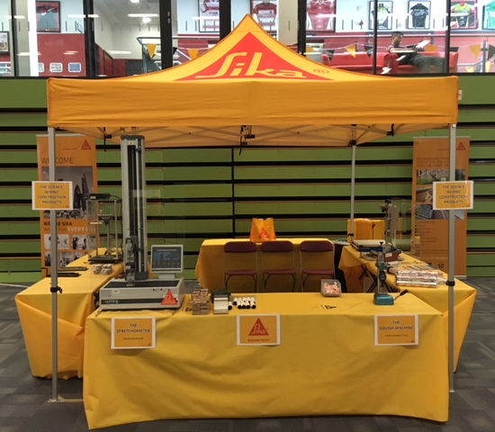
Do you remember?
Do you remember seeing us at the Lancashire Science Festival?
This was our stand…

Slide 4
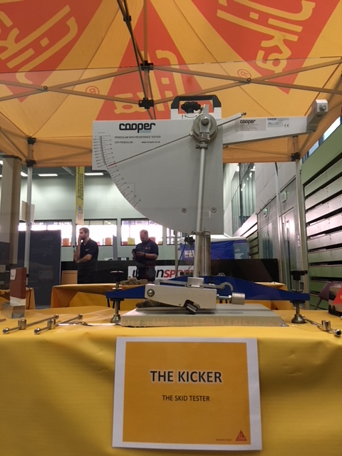
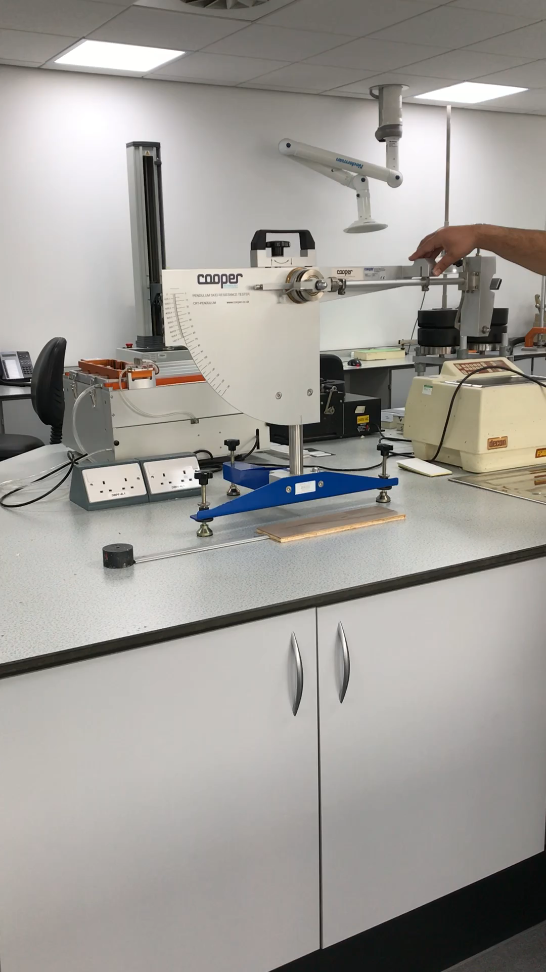
The Kicker
One of the pieces of equipment on our stand was “The Kicker”.
We use it to test how slippy a surface is.
Video
Notes:
Could we have a short video of the kicker in use?

Slide 5
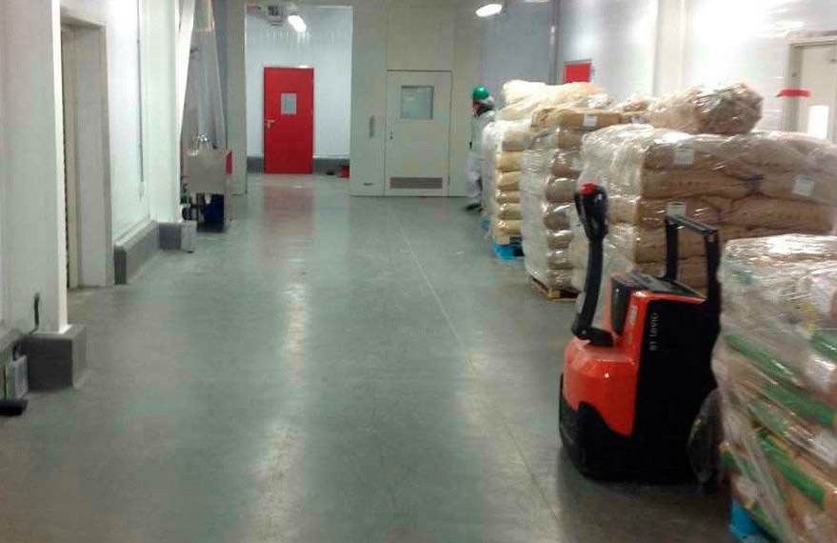
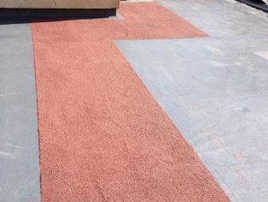
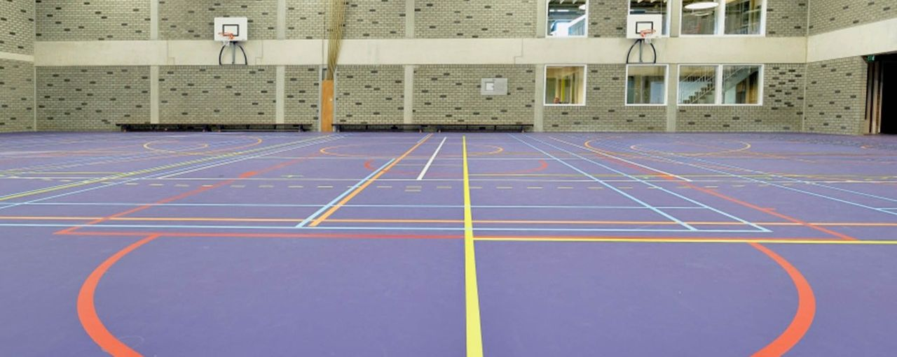
Why do we test this?
There are rules about how slippy a floor can be and we need to know whether our products fit these rules.
If we change the type or quantity of ingredients we use when making our flooring products it might change how slippy they are.
Notes:
Ask Sarah James to send some photos

Slide 6
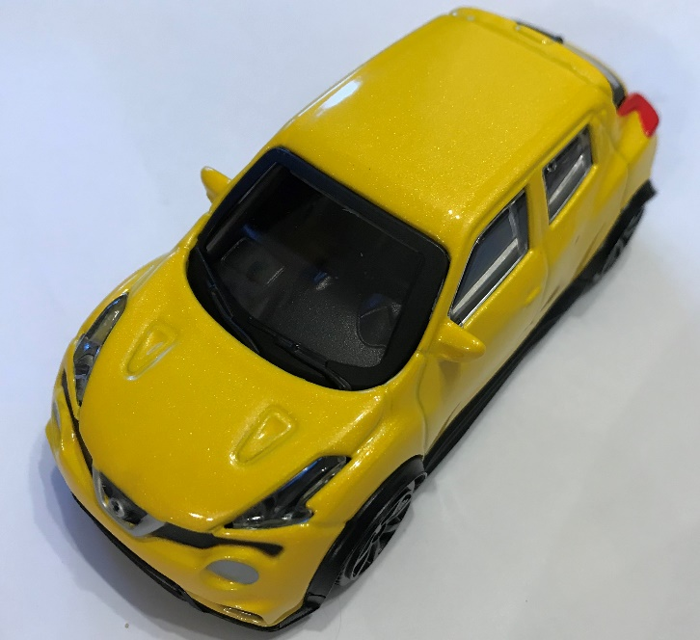
Investigating Surfaces
Learning Objective:
To compare how things move on different surfaces
Today, we are going to carry out a similar investigation. We are going to test how far a toy car moves on different surfaces.
Talking partners:
How do you think we could do this?

Slide 7
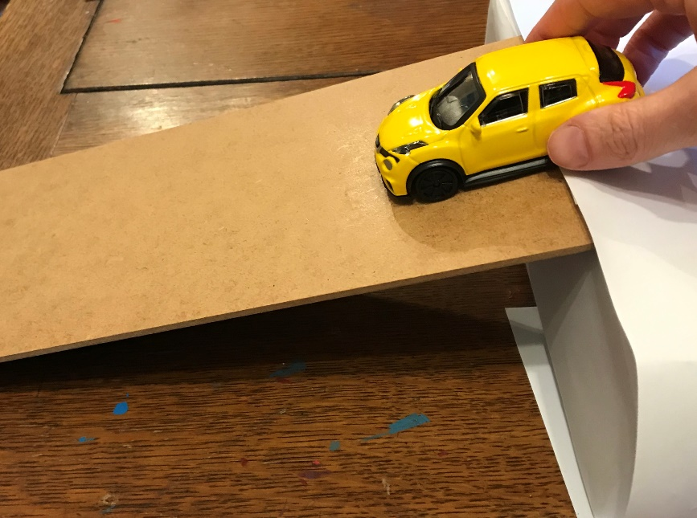
Our test
We will be using a ramp, toy cars and different surfaces at the bottom of the ramp. The toy car can then be put at the top of the ramp and let go so it rolls down the ramp and then onto the surface. We will then be able to use a tape measures to measure how far the toy car travelled on the surface.
How can we make this a fair test?

Slide 8
Our test
The surfaces we will be testing are:
(TEACHER TO INPUT CHOSEN SURFACES)
Which surface will the car travel the furthest on?
Which surface will the car travel the least furthest on?
Please complete your predictions on your worksheet.
Now let’s complete our investigation.

Slide 9
plenary
What did we find out from our investigation?

